Slide 1
Providence Mutual Website
Start Date - 7/6/17
End Date - 8/15/17
Stephanie Racca

Slide 2
Background
Child Theme of Sydney by aThemes
Notable Features of Site
Custom Testimonials
Responsive Image Boxes
Toggle-Based Information
Pop-Up Information
Agent Finder
Notable Features of Sydney
Large Hero Image with Sliding Text on Front Page
Traveling Navigation Menu
Notable Features of Child Theme
2nd Navigation Menu for Important Consumer Links
Solid Navigation Menu Background
General Stylistic Changes

Slide 3
Navigation

Slide 4
Navigation
Features
Static Search Bar
Static Footer Containing Social Media and Legal Jargon
Navigation Menu with Drop Down Sub-Menus

Slide 5
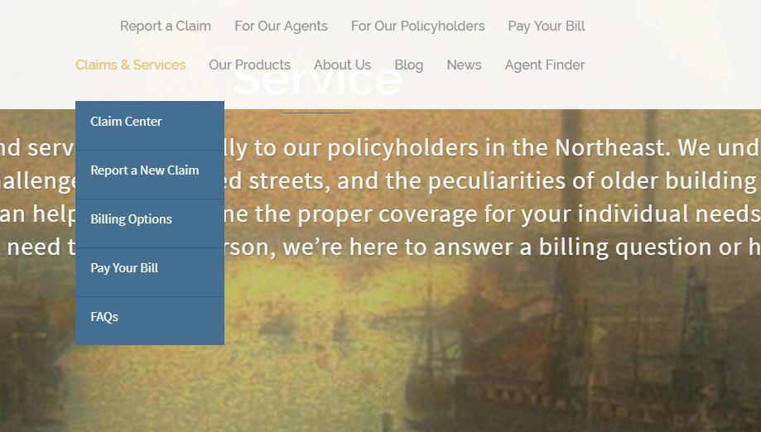

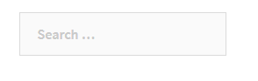
If there is a sub-menu, the main tab is highlighted and the drop-down is displayed. If not, main tab is just highlighted.

Slide 6
Home Page

Slide 7
Home Page
Features
Large Hero Image, Sliding Between 4 Paragraphs
Icon Menu of Quick Links
Static News Slider
Testimonials Switch Every 8 Second or on Interaction

Slide 8
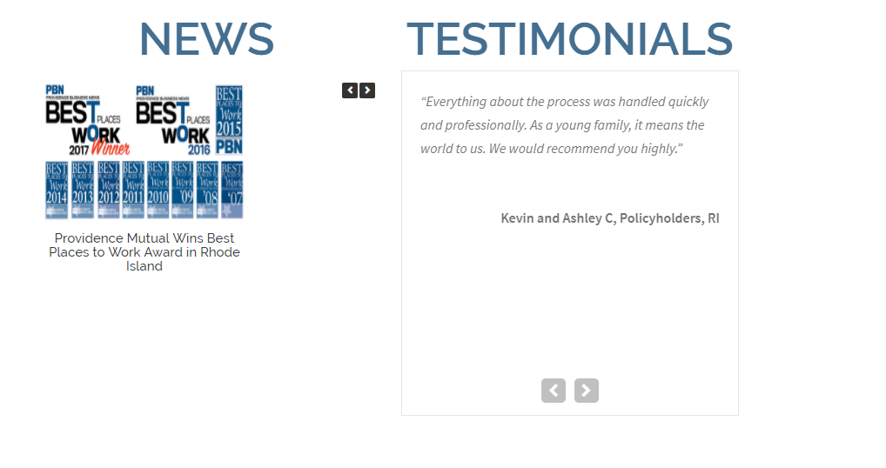


Slide 9
Claim Center

Slide 10
Claim Center
Features
Sidebar menu of left is static for all pages under Claims & Services label. It is a similar situation for almost all pages under the same label.

Slide 11
Report a New Claim

Slide 12
Report a New Claim
Features
Testimonial Slider
Interactive Form for Reporting New Claim

Slide 13
Caldera Form
Form features include: date/state picker, options, single line text, paragraph text, cancel button (clears form), and submit.

Slide 14
Billing Options & Pay Your Bill

Slide 15
Billing Options & Pay Your Bill
Features
Table for User Ease

Slide 16
Billing Options
Pay Your Bill

Slide 17
FAQs

Slide 18
FAQs
Features
Responsive Toggle Feature, for Information Access

Slide 19
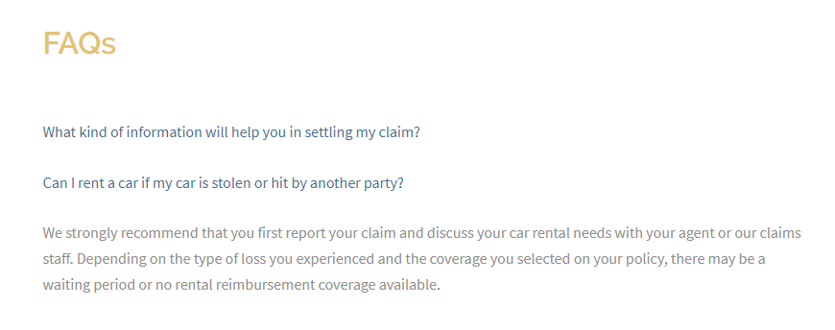

Slide 20
Product Overview

Slide 21
Product Overview
Gives Basic Summary of Our Products

Slide 22
Homeowners

Slide 23
Homeowners
Features
Responsive Images with ‘See More’ Pop-Ups
Case Study with ‘See More’ Pop-Up
‘Ask Your Agent’ Slider

Slide 24
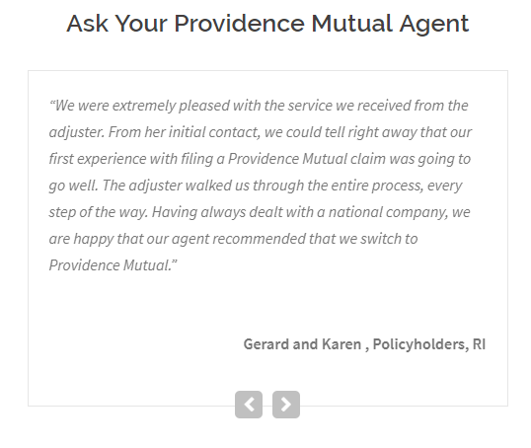
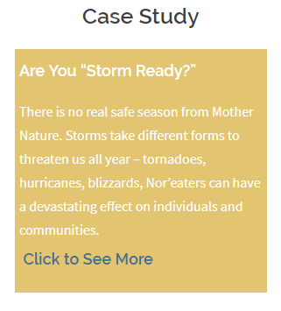


Slide 25
Renters

Slide 26
Renters
Features
Responsive Hover Images
‘Helpful Tips’ Slider

Slide 27
Condo Owners

Slide 28
Condo Owners

Slide 29
Landlords

Slide 30
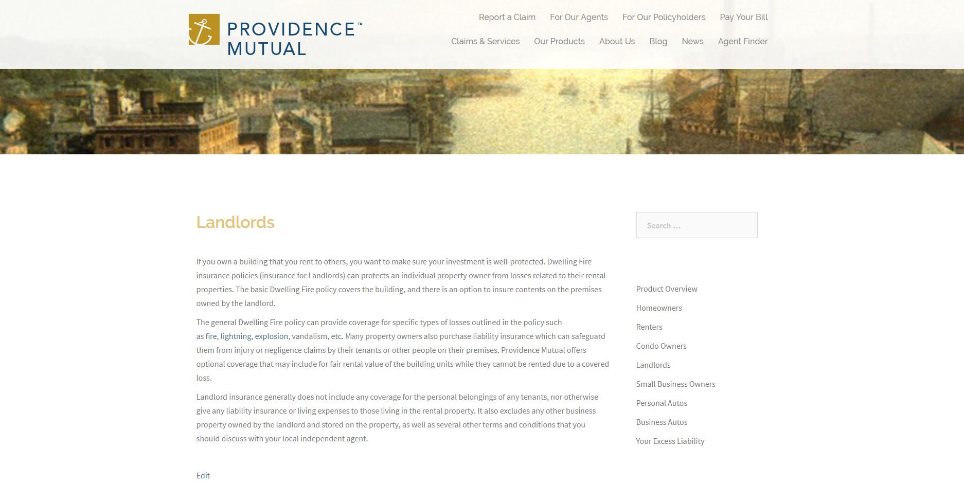
Landlords

Slide 31
Small Business Owners

Slide 32
Small Business Owners
Features
Responsive Hover Images
Case Study with Pop-Up

Slide 33
Personal Autos

Slide 34
Personal Autos
Features
Responsive Hover Images
Case Study with Pop-Up

Slide 35
Business Autos

Slide 36

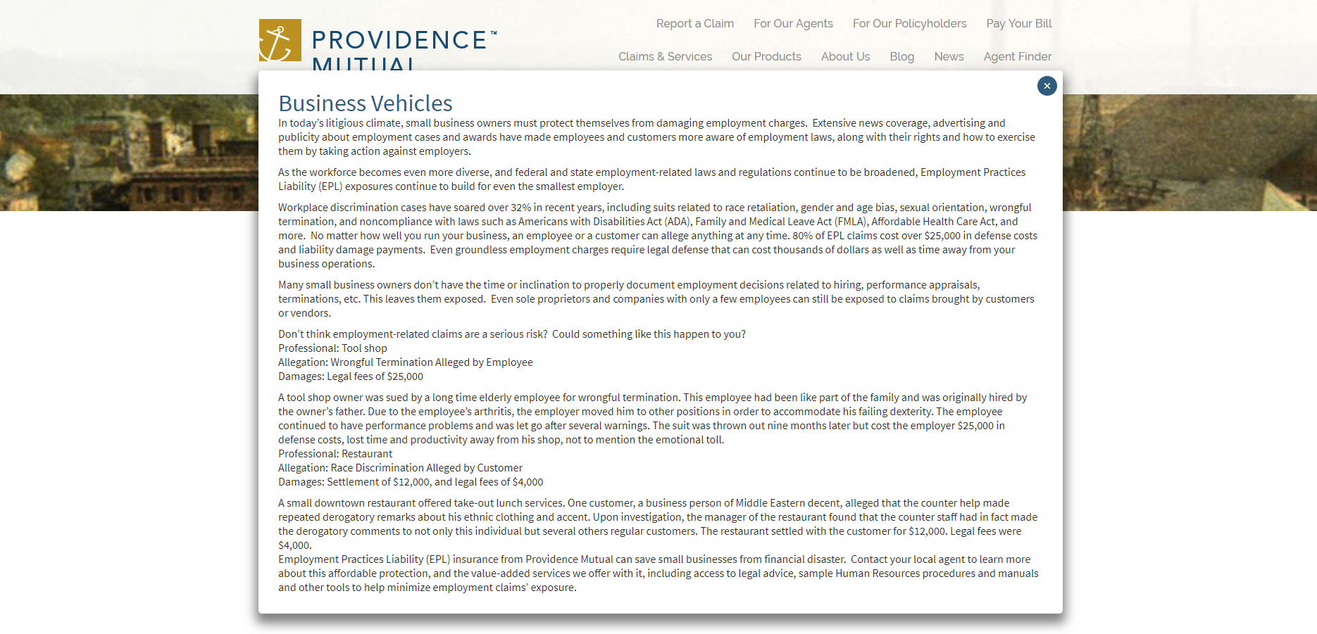
Business Autos
Features
Case Study with Pop-Up

Slide 37
Your Excess Liability

Slide 38
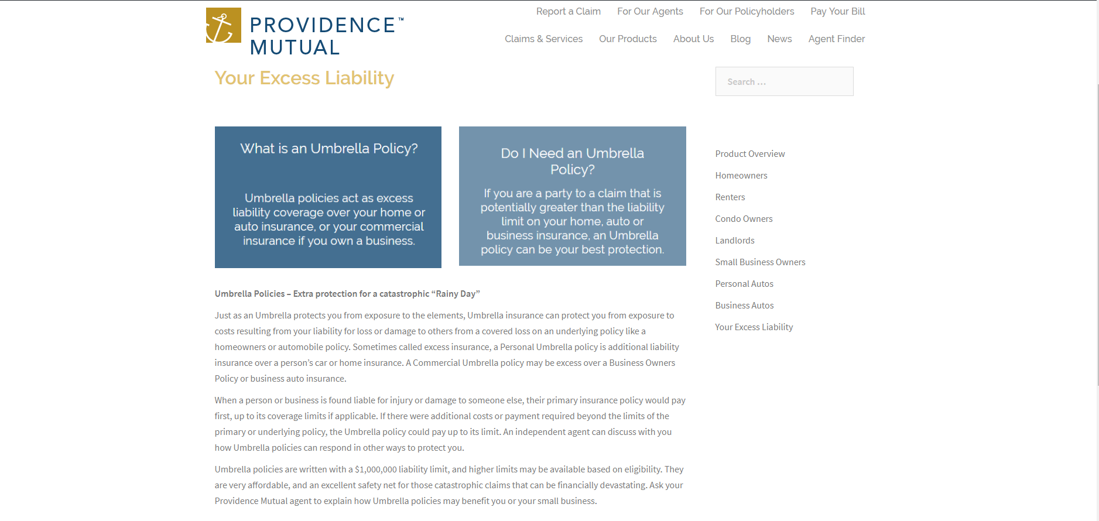
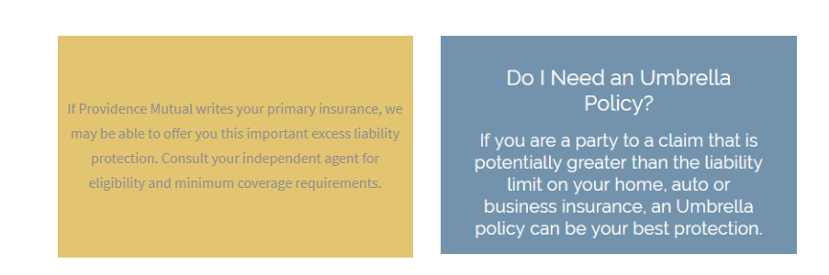

Slide 39
History

Slide 40
History
Features
Responsive Toggle Feature
Interactive Button to Next Page

Slide 41
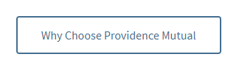

Button
Toggle
Responsive Button Links To Next Page
Can View One at a Time, or all at Once

Slide 42
Why Providence Mutual?

Slide 43
Why Providence
Features
Testimonial Slider

Slide 44
President’s Message

Slide 45
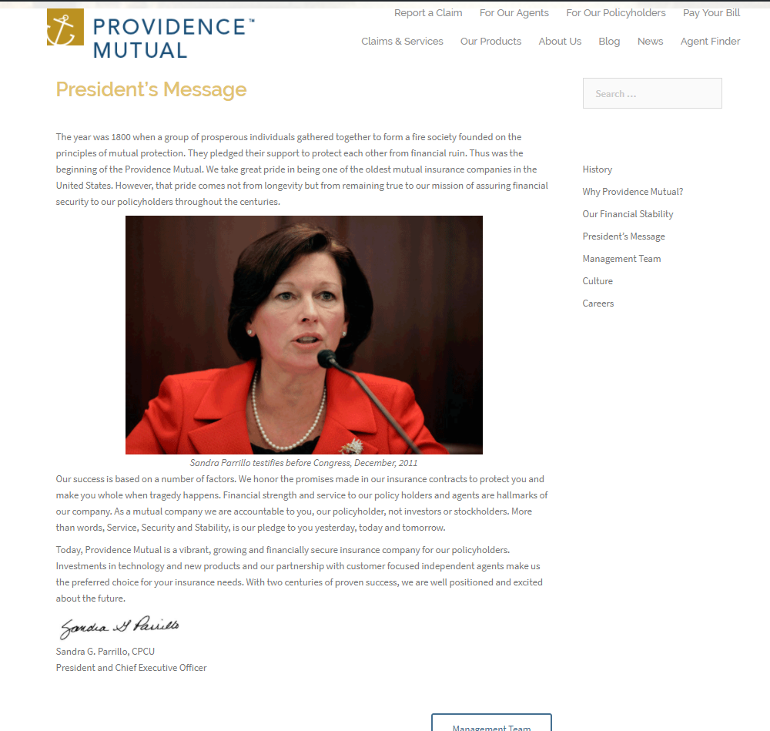
President’s Message

Slide 46
Management Team

Slide 47
Management Team
Features
Pop-Up Information for Team

Slide 48
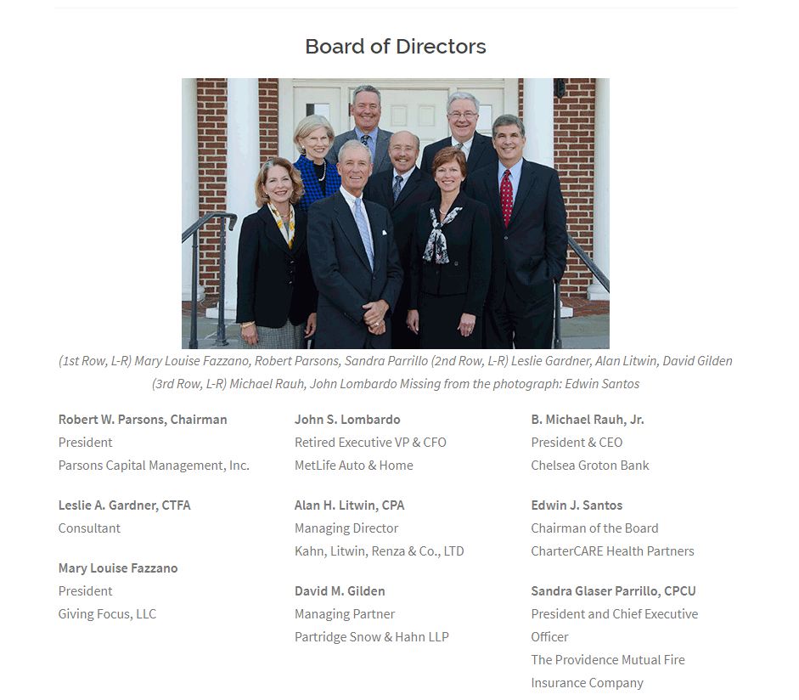
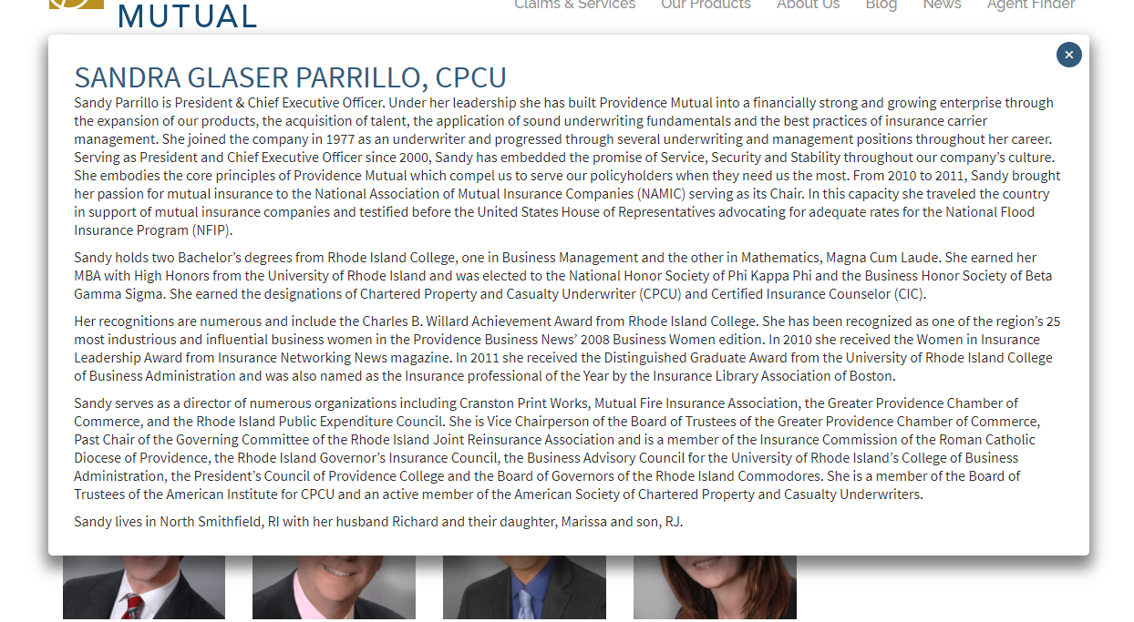


Slide 49
Careers

Slide 50
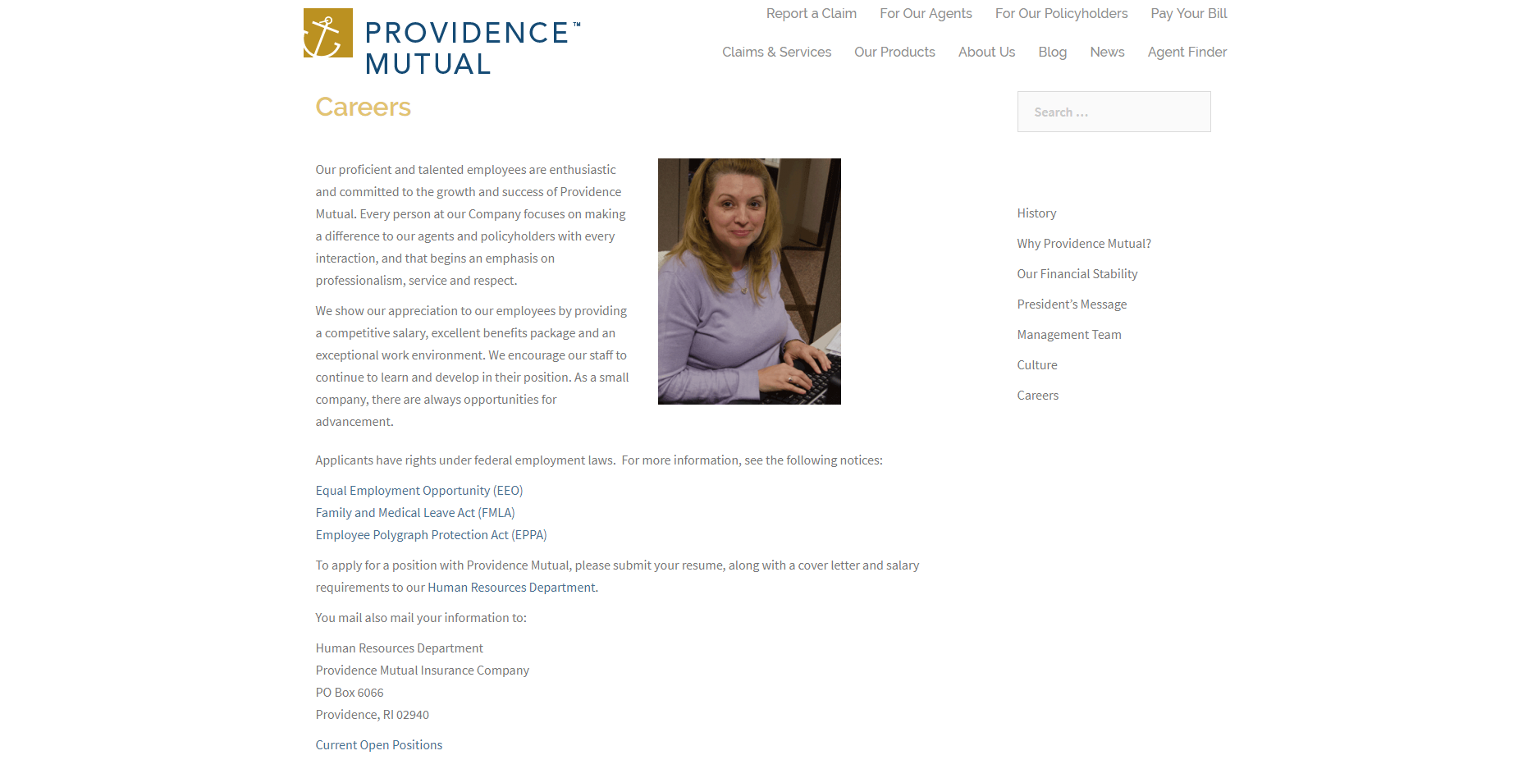
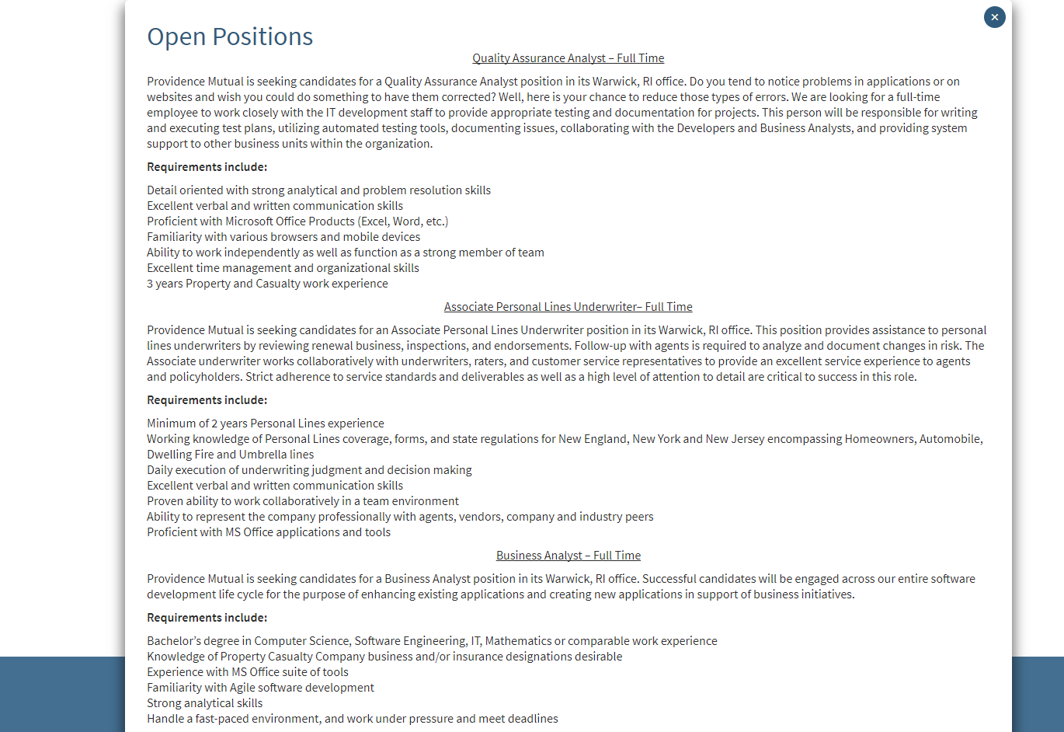
Careers
Features
Current Open Positions Pop-Up

Slide 51
Culture

Slide 52
Culture
Features
Image Slider

Slide 53
Our Financial Stability

Slide 54
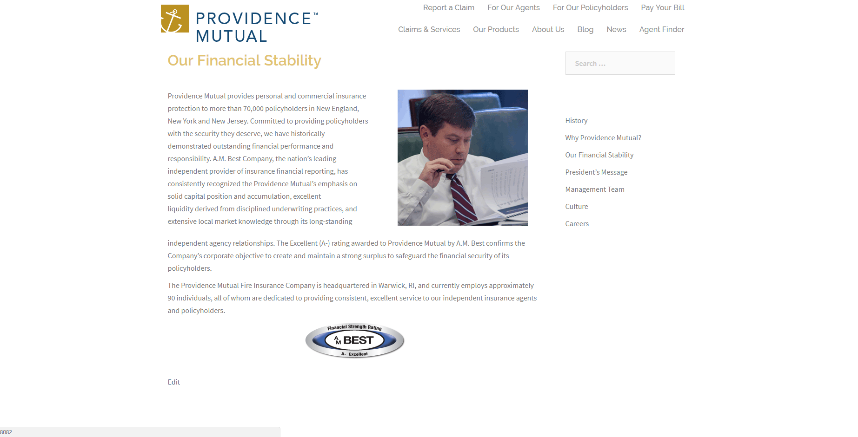
Our Financial Stability

Slide 55
Blog

Slide 56
Blog
Features
Responsive Slider to View Posts
Interactive Posts with Header Image

Slide 57
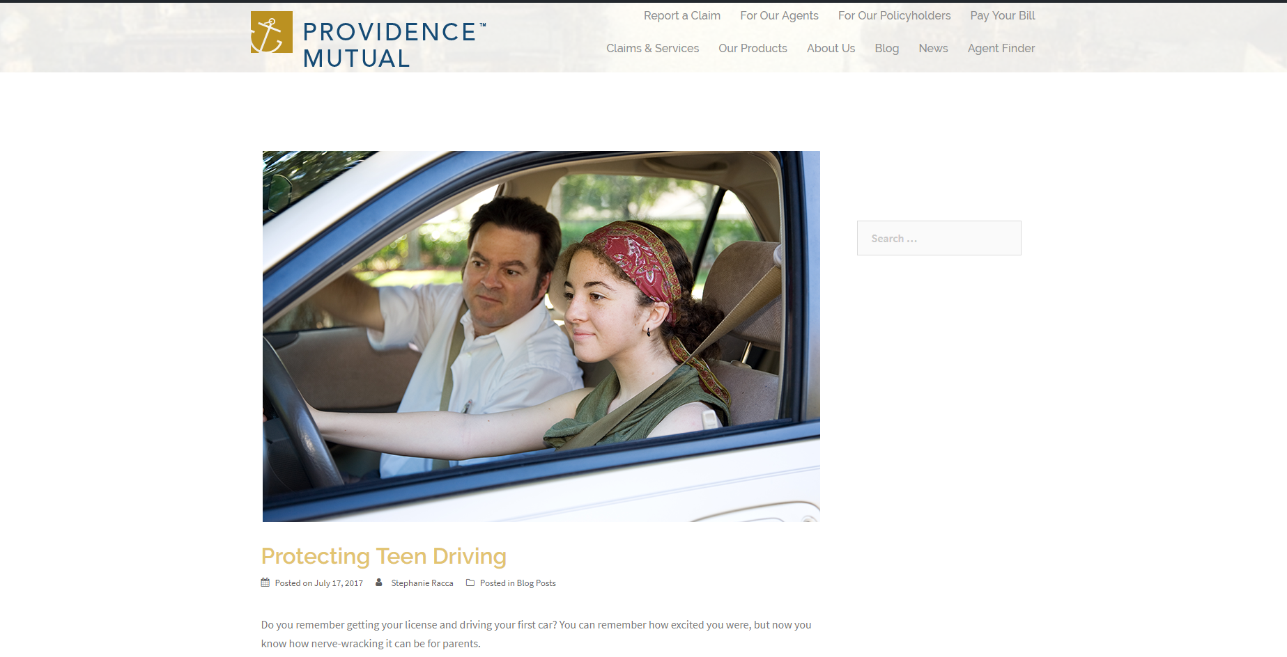
Slider
Sample Post

Slide 58
News

Slide 59
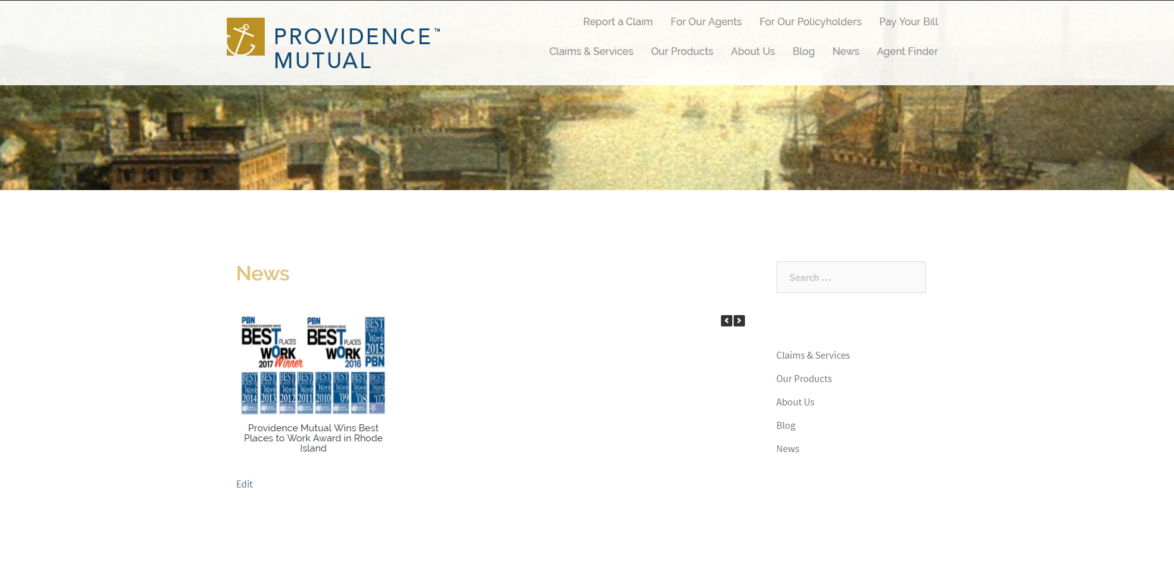
Culture
Features
Responsive Slider to View Posts
Interactive Posts with Header Image

Slide 60
Agent Finder

Slide 61
Agent Finder
Features
Enter a Location to Search
Selection of Search Radius and Amount of Locations Shown
Lists either all locations if not in use, or selected amount if in use.
Zoom in and Out
Directions via Google Maps
Responsive Locations and Map Animations

Slide 62
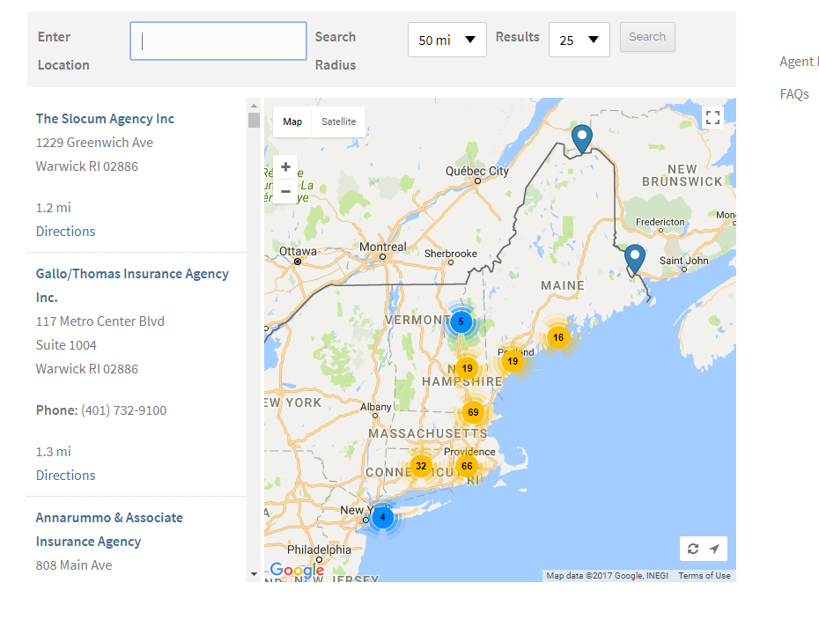
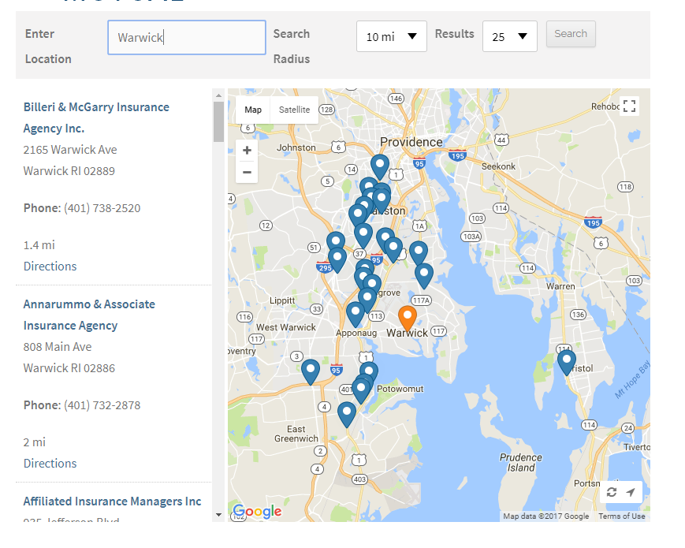

Slide 63
Questions or Comments?
In Summary
User Ease is at the Forefront
Clear Minimalist Theme for a Business Environment
Responsive Content for ‘Wow Factor’

